Slide 1
Linked list
Dr. Shatarupa Dash

Slide 2
Linked list
What is linked list?
Why you need linked list?
Types of linked list
Operation

Slide 3
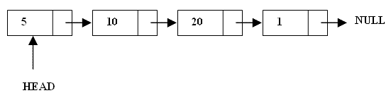
Linked list
A linked list is a linear data structure.
Nodes make up linked lists.
Nodes are structures made up of data and a pointer to another node.
Usually the pointer is called next.

Slide 4
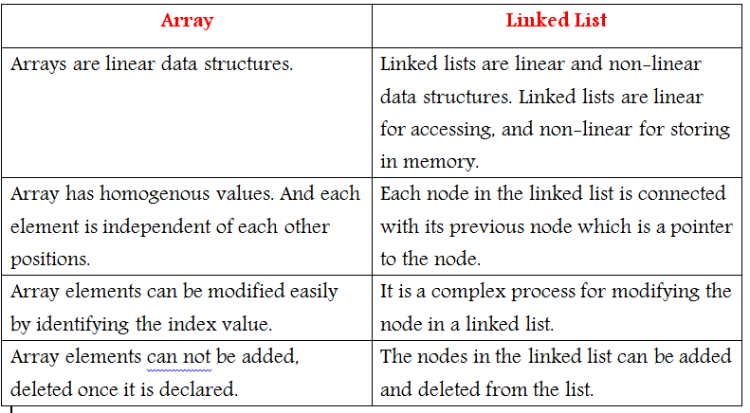
ARRAY VS LINKED LIST

Slide 5
Types of linked list
Singly linked list
Doubly linked list
Circular linked list

Slide 6
Singly linked list(SLL)
Each node has only one link part(Address to next node).
Each link part contains the address of the next node in the list.
Link part of the last node contains NULL value which signifies the end of the node.(last node in list)

Slide 7
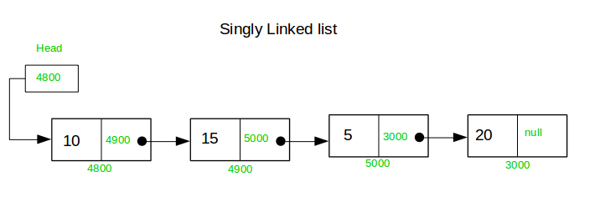
Graphical Representation of SLL

Slide 8
BASIC OPERATION ON LINKED LIST
Create a List
Insert an element in a list
Delete an element from a list
Searching a list
Display a list

Slide 9
Lets see operations on SLL
Data next
pointer
Represent a null in this ppt
Terminologies
This node’s next pointer is null
Note: The animation made in this presentation are made for my teaching. They may not work as a good reference for some. However, I believe it might help better understanding at some point.
-Dr. Shatarupa Dash

Slide 10
Create
P
Scanner sc=new Scanner (System.in);
info
null
do{
node p=new node();
p.regd_no=sc.nextInt();
p.mark=sc.nextFloat();
p.next=null;
if(start==null){
start=p;
q=p;
}
else {
q.next=p;
q=p;
}
System.out.println("Enter(y/Y) to add next value of node.");
ch=sc.next().charAt(0);
}while(ch=='y'||ch=='Y');
return start;
start
Points to last node
q
start
P
q

Slide 11
Insert at the beginning
start
Scanner sc=new Scanner (System.in);
node p=new node();
p.regd_no=sc.nextInt();
p.mark=sc.nextFloat();
p.next=start;
start=p;
return start;
2
1
1
2
p

Slide 12
Insert at the end
start
Scanner sc=new Scanner (System.in);
node s=new node();
node p=new node();
System.out.println(“info.");
p.regd_no=sc.nextInt();
p.mark=sc.nextFloat();
s=start;
p.next=null;
while(s.next!=null)
{s=s.next;}
s.next=p;
s
p

Slide 13
Delete at the beginning
start
start=start.next;
x

Slide 14
Delete at the end
start
s
x
q
q
s
q
s
q
s
node s=start;
node q=new node();
while(s.next!=null){
q=s;
s=s.next;
}
q.next=null;

Slide 15
Insert at a specific position
start
s
X
p.next=s.next;
s.next=p;
2
1
p

Slide 16
Insert at a specific position
s
Scanner sc=new Scanner (System.in);
node s=new node();
node p=new node();
System.out.println("Enter regd no and marks.");
p.regd_no=sc.nextInt();
p.mark=sc.nextFloat();
s=start;
p.next=null;
System.out.println("Enter location.");
int loc=sc.nextInt();
for(int i=1;i<loc-1 && s.next!=null;i++){
s=s.next;
}
p.next=s.next;
s.next=p;
X
p.next=s.next;
s.next=p;
2
1
p
If you want to insert at 3rd ,
Add after 2nd
i<loc-1

Slide 17
Delete at a specific position
q.next=s.next;
start
s
q
q
s
q
s
Scanner sc=new Scanner (System.in);
node s=start;
node q=new node();
System.out.println("Enter location.");
int loc=sc.nextInt();
for(int i=1;i<loc && s.next!=null;i++){
q=s;
s=s.next;
}
q.next=s.next;

Slide 18
Display all nodes
node s=null;
s=start;
if(start==null){
System.out.println("List is empty.");
}
else{
while(s!=null){
System.out.print("Regd no.- "+s.regd_no+" Mark- "+s.mark+" -> ");
s=s.next;

Slide 19
Search a node
node s=new node();
s=start;
if(start==null){
System.out.println("List is empty.");
}
Else
{
Scanner sc=new Scanner (System.in);
System.out.println("Enter Regd no. to be searched");
int r=sc.nextInt();
while(s!=null){
if(r==s.regd_no){
System.out.print("Enter updated marks.");
s.mark=sc.nextFloat();
}
s=s.next;
}
}

Slide 20
Doubly linked list

Slide 21
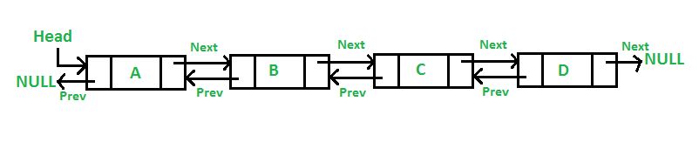
Doubly linked list
class Node
{
protected Node prev;
protected Node next;
protected float mark;
protected int regd_no;
}

Slide 22
Create
P
Scanner sc=new Scanner (System.in);
null
info
null
do{
Node p=new Node();
p.regd_no=sc.nextInt();
p.mark=sc.nextFloat();
p.next=null;
p.prev=null;
if(start==null||end==null){
start= end= p;
}
else {
end.next=p;
p.prev=end;
end=p;
}
System.out.println("Enter(y/Y) to add next");
ch=sc.next().charAt(0);
}while(ch=='y'||ch=='Y');
start
Points to last node
end
P
start
P
end
end

Slide 23
Insert at the beginning
start
Scanner sc=new Scanner (System.in);
Node p=new Node();
p.prev=null;
p.next=null;
System.out.println("Enter Regd no. and Marks.");
p.regd_no=sc.nextInt();
p.mark=sc.nextFloat();
p.next=start;
Start.prev=p;
start=p;
p
1
2
3
1
3
start
2
start

Slide 24
Insert at the end
start
p
s
Node s=new Node();
Node p=new Node();
s=start;
System.out.println("Enter Regd no. and Marks.");
p.regd_no=sc.nextInt();
p.mark=sc.nextFloat();
p.next=null;
p.prev=null;
while(s.next!=null)
{s=s.next;}
s.next=p;
p.prev=s;

Slide 25
Delete at the beginning
start
start=start.next;
start.prev= null;

Slide 26
Delete at the end
start
s
x
q
q
s
q
s
q
s
node s=start;
node q=new node();
while(s.next!=null){
q=s;
s=s.next;
}
s.prev=null;
q.next=null;

Slide 27
Insert at a specific position
start
s
2
p.next=s.next;
p.prev=s;
1
s.next=p;
p.next.prev=p;
4
3
p

Slide 28
Insert at a specific position
s
Node s=start;
Node p=new Node();
System.out.println("Enter Regd no. and Marks.");
p .regd_no=sc.nextInt();
p.mark=sc.nextFloat();
System.out.println("Enter location.");
int loc=sc.nextInt();
for(int i=1;i<loc-1 && s.next!=null;i++)
{
s=s.next;
}
p.prev=s;
p.next=s.next;
s.next.prev=p;
s.next=p;
return start;
p.next=s.next;
1
2
p.next.prev=p;
4
p.prev=s;
s.next=p;
3
p

Slide 29
Delete at a specific position
start
q
s
X
Node s=start;
Node q=new Node();
System.out.println("Enter location.");
int loc=sc.nextInt();
for(int i=1;i<loc && s.next!=null;i++){
q=s;
s=s.next;
}
System.out.println(“Deleting"+s);
q.next=s.next;
s.next.prev=q;
return start;

Slide 30
Circular linked list

Slide 31
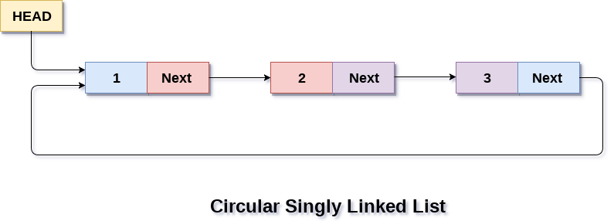

Slide 32
Create
P
Scanner sc=new Scanner (System.in);
info
null
do{
node p=new node();
p.regd_no=sc.nextInt();
p.mark=sc.nextFloat();
p.next=null;
if(start==null){
start=p;
q=p;
q.next=start;
}
else {
q.next=p;
q=p;
q.next=start;
}
System.out.println("Enter(y/Y) to add next value of node.");
ch=sc.next().charAt(0);
}while(ch=='y'||ch=='Y');
return start;
start
Points to last node
q
start
P
q

Slide 33
Insert at the beginning
Scanner sc=new Scanner (System.in);
node p=new node();
node s=null;
p.regd_no=sc.nextInt();
p.mark=sc.nextFloat();
s=start;
While(q.next!=start)
{s=s.next;}
p.next=start;
start=p;
s.next=start;
return start;
start
s
2
1
1
2
3
3
p

Slide 34
Insert at the end
Scanner sc=new Scanner (System.in);
node s=new node();
node p=new node();
System.out.println(“info.");
p.regd_no=sc.nextInt();
p.mark=sc.nextFloat();
s=start;
p.next=null;
while(s.next!=start) //new
{s=s.next;}
p.next=start;
s.next=p;
start
s
p

Slide 35
Delete at the beginning
start
S
Scanner sc=new Scanner (System.in);
node s=new node();
while(s.next!=start) //new
{s=s.next;}// S IS THE LAST NODE
start=start.next;
s.next=start;

Slide 36
Delete at the end
start
s
x
q
q
s
q
s
q
s
node s=start;
node q=new node();
while(s.next!=start){
q=s;
s=s.next;
}
q.next=start;

Slide 37
Insert at a specific position
start
s
X
p.next=s.next;
s.next=p;
2
1
p

Slide 38
Insert at a specific position
s
Scanner sc=new Scanner (System.in);
node s=new node();
node p=new node();
System.out.println("Enter regd no and marks.");
p.regd_no=sc.nextInt();
p.mark=sc.nextFloat();
s=start;
p.next=null;
System.out.println("Enter location.");
int loc=sc.nextInt();
for(int i=1;i<loc-1 && s.next!=null;i++){
s=s.next;
}
p.next=s.next;
s.next=p;
X
p.next=s.next;
s.next=p;
2
1
p
x
start
If you want to insert at 3rd ,
Add after 2nd
i<loc-1

Slide 39
Delete at a specific position
q.next=s.next;
start
s
q
q
s
q
s
Scanner sc=new Scanner (System.in);
node s=start;
node q=new node();
System.out.println("Enter location.");
int loc=sc.nextInt();
for(int i=1;i<loc && s.next!=null;i++){
q=s;
s=s.next;
}
q.next=s.next;
x
start

Slide 40
THANK YOU!

